Slide 1
Deadlock, Starvation
Hamid R. Zarandi
h_zarandi@aut.ac.ir

Slide 2
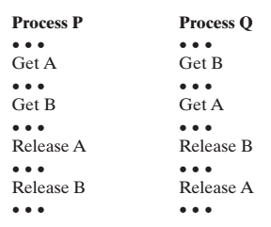
Why is deadlock handling important?
Deadlocks prevent sets of concurrent processes from completing their tasks

Slide 3
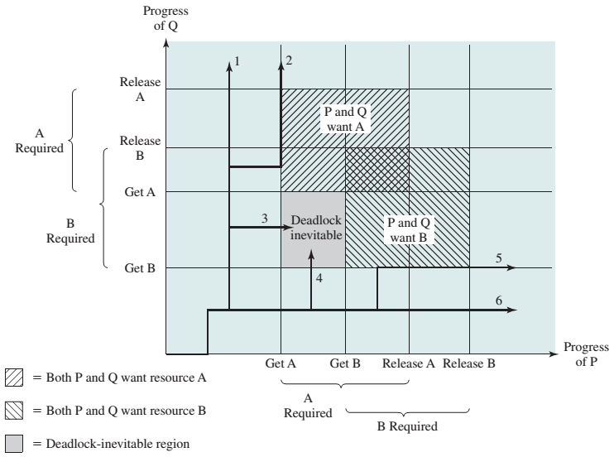
Deadlock diagram of 2 processes

Slide 4
Deadlock
Definition
To wait for a resource which is to acquired by another process that is waited for a resource of requesting process
Never finishing wait state
Circular dependencies between processes

Slide 5
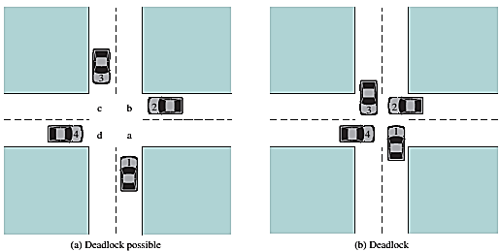
Illustration of deadlock

Slide 6
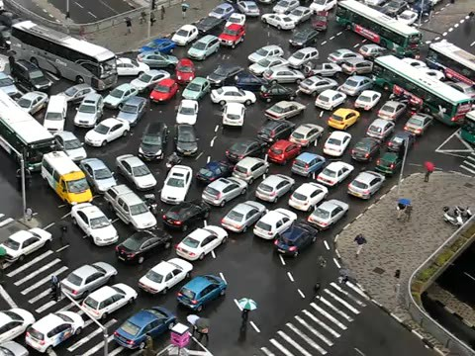
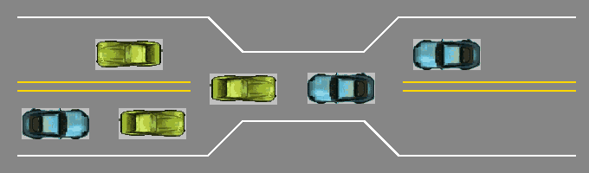
Deadlock

Slide 7
Necessary conditions
Mutual exclusion
only one process at a time can use a resource
Hold and wait
a process holding at least one resource is waiting to acquire additional resources held by other processes
No preemption
a resource can be released only voluntarily by the process holding it, after that process has completed its task
Circular wait
there exists a set {P₀, P₁, …, P_{n}} of waiting processes such that P₀ is waiting for a resource that is held by P₁, P₁ is waiting for a resource that is held by P₂, …, P_{n–1} is waiting for a resource that is held by P_{n}, and P_{n} is waiting for a resource that is held by P₀.

Slide 8
How to model deadlock?
System consists of resources
Resource types R₁, R₂, . . ., R_{m}
CPU cycles, memory space, I/O devices
Each resource type R_{i} has W_{i} instances.
Each process utilizes a resource as follows:
request
use
release

Slide 9
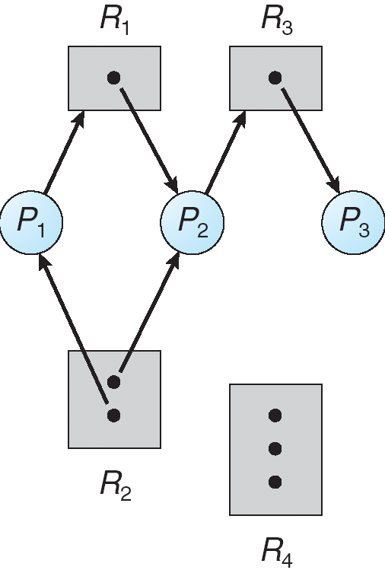
Resource-allocation graph
Directed graph
Nodes = {Processes, Resources}
Edges = {Request edges: P_{i} → R_{j}, Assignment edges: R_{j} → P_{i} }
Process
Resource Type with 4 instances
P_{i} requests instance of R_{j}
P_{i} is holding an instance of R_{j}
P_{i}
P_{i}

Slide 10
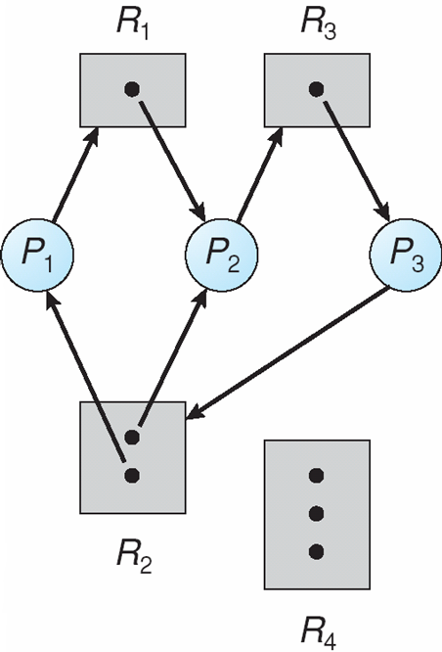
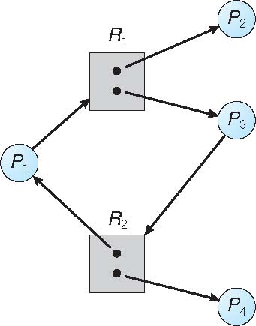
Is there a deadlock?

Slide 11
Deadlock illustration in RAG
Having 1 resource in each resource type
Deadlock ⬄ existing a cycle
Having multiple resources for at least one resource type
Deadlock is possible (not necessary) when existing a cycle
No Cycle → No deadlock
One cycle →
(one instance per resource type): deadlock
(multiple instances per resource type): possible of deadlock

Slide 12
How to handle deadlocks?
1) Prevent or 2)avoid deadlocks
Deadlock prevention
To ensure at least one of necessary condition cannot hold.
Deadlock avoidance
Conservative: May current req make a deadlock in future (non safe state)?
3) Detect & recover deadlocks
1st detect, next recover (how?)
4) Do nothing: Ostrich algorithm!
Modern OS: Windows, Linux

Slide 13
1) Deadlock prevention (جلوگیری)
Prevent deadlock by missing one of:
~ Mutual exclusion
Make resources sharable: read-only files
Is not possible in all cases
~ Hold & wait
How?
Request all resources before execution
Request a resource if no others it have
Drawbacks
Underutilization of resources
Starvation
~ No preemption
3 solutions exist = {self preemption, dest process preemption, save & switch resource status}
~ Circular wait
Request a resource in an increasing order of enumeration

Slide 14
Example of prevention of circular wait
Example of ~circular wait
F(tape drive) = 1
F(disk drive) = 5
F(printer) = 12
After having resource type R_{i} request to resource type R_{j} is possible if F(R_{j})>F(R_{i})
Otherwise, release all resource types R_{k} where F(R_{k})>=F(R_{j})

Slide 15
2) Deadlock avoidance (اجتناب)
Prevention is bad (why?)
Resource underutilization
Reduced throughput
Avoidance is good; How to avoid?
Required extra info
Available resources
Resources allocated to processes
Future request of processes (!)
Definition:
Safe state
Solutions
1) Resource-allocation-graph algorithm (single instance resource type)
2) Banker’s algorithm (multiple instance resource type)

Slide 16
Safe state definition
When a process requests an available resource, system must decide if immediate allocation leaves the system in a safe state
Safe state: there exists a sequence <P₁, P₂, …, P_{n}> of ALL the processes in the systems such that for each P_{i}, the resources that P_{i} can still request can be satisfied by currently available resources + resources held by all the P_{j}, with j < i
That is:
If P_{i} resource needs are not immediately available, then P_{i} can wait until all P_{j} have finished
When P_{j} is finished, P_{i} can obtain needed resources, execute, return allocated resources, and terminate
When P_{i} terminates, P_{i +1} can obtain its needed resources, and so on

Slide 17
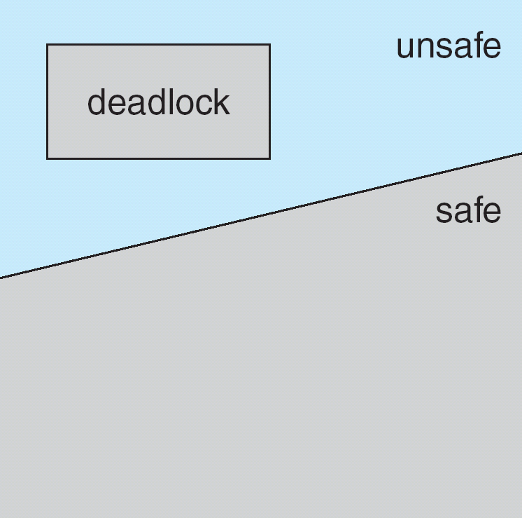
Safe state definition
If a system is in safe state ⇒ no deadlocks
If a system is in unsafe state ⇒ possibility of deadlock
Avoidance ⇒ ensure that a system will never enter an unsafe state.

Slide 18
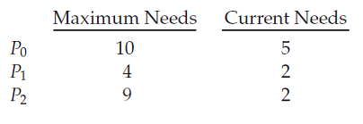
Safe mode example (1)
3 processes: P₀, P₁, P₂
1 resource type: A (12)
Snapshot at time T₀
Safe mode sequence?
<P₁,P₀,P₂>

Slide 19
Safe mode example (2)
3 processes: P₀, P₁, P₂
1 resource type: A (12)
Snapshot at time T₀
Suppose that, at time T1, process P2 requests and is allocated one more resource.
Safe mode sequence?
no safe

Slide 20
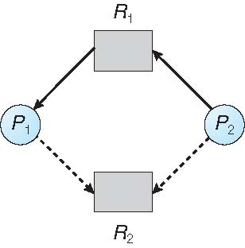
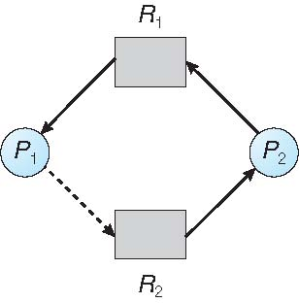
2.1) Resource-allocation graph (RAG) algorithm
Claim edge P_{i} → R_{j} indicated that process P_{i} may request resource R_{j} represented by a dashed line
unsafe state

Slide 21
2.1) Resource-allocation graph (RAG) algorithm
Suppose that process P_{i} requests a resource R_{j}
The request can be granted only if converting the request edge to an assignment edge does not result in the formation of a cycle in the resource allocation graph

Slide 22
2.2) Banker’s algorithm
Let n = number of processes, and m = number of resources types.
Available: Vector of length m.
If available [j] = k, there are k instances of resource type R_{j} available
Max: n x m matrix.
If Max [i,j] = k, then process P_{i} may request at most k instances of resource type R_{j}
Allocation: n x m matrix.
If Allocation[i,j] = k then P_{i} is currently allocated k instances of R_{j}
Need: n x m matrix.
If Need[i,j] = k, then P_{i} may need k more instances of R_{j} to complete its task
Need [i,j] = Max[i,j] – Allocation [i,j]

Slide 23
2.2) Banker’s algorithm: Safety algorithm
1. Let Work and Finish be vectors of length m and n, respectively. Initialize:
Work = Available
Finish [i] = false for i = 0, 1, …, n- 1
2. Find an i such that both:
(a) Finish [i] = false
(b) Need_{i} ≤ Work
If no such i exists, go to step 4
3. Work = Work + Allocation_{i} Finish[i] = true go to step 2
4. If Finish [i] == true for all i, then the system is in a safe state

Slide 24
2.2) Banker’s algorithm: Resource-request algorithm for process P_{i}
Request_{i} = request vector for process Pi
If Request_{i} [j] = k then process P_{i} wants k instances of resource type R_{j}
1. If Request_{i} ≤ Need_{i}
go to step 2
else
raise error condition (process has exceeded its maximum claim)
2. If Request_{i} ≤ Available
go to step 3
else
P_{i} must wait (resources are not available)
3. Pretend to allocate requested resources to Pi by modifying the state as follows:
Available = Available - Request_{i}
Allocation_{i} = Allocation_{i} + Request_{i}
Need_{i} = Need_{i} – Request_{i}
If safe ⇒ the resources are allocated to Pi
If unsafe ⇒ Pi must wait, and the old resource-allocation state is restored

Slide 25
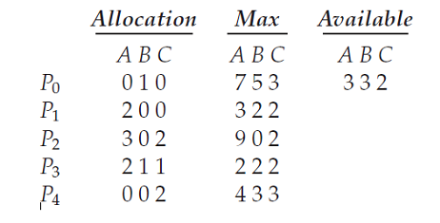
Banker’s algorithm example
5 processes P₀ through P₄
3 resource types: A = 10 B = 5 C=7
Snapshot at time T₀:

Slide 26
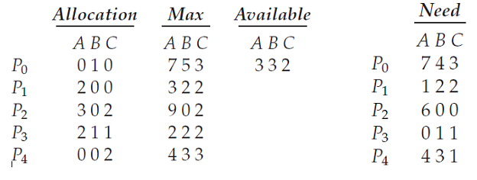
Banker’s algorithm example
The content of the matrix Need is defined to be Max – Allocation
Is the system safe?
Yes. The sequence <P₁, P₃, P₄, P₂, P₀> satisfies safety criteria

Slide 27
Example: P₁ Request (1,0,2)
Check that Request ≤ Available (that is, (1,0,2) ≤ (3,3,2) ⇒ true)
Allocation Need Available
A B C A B C A B C
P₀ 0 1 0 7 4 3 2 3 0
P₁ 3 0 2 0 2 0
P₂ 3 0 2 6 0 0
P₃ 2 1 1 0 1 1
P₄ 0 0 2 4 3 1
Executing safety algorithm shows that sequence < P₁, P₃, P₄, P₀, P₂> satisfies safety requirement
Can request for (3,3,0) by P₄ be granted?
Can request for (0,2,0) by P₀ be granted?

Slide 28
3) Deadlock detection & recovery
Allow system to enter deadlock state
Detection algorithm
Recovery scheme

Slide 29
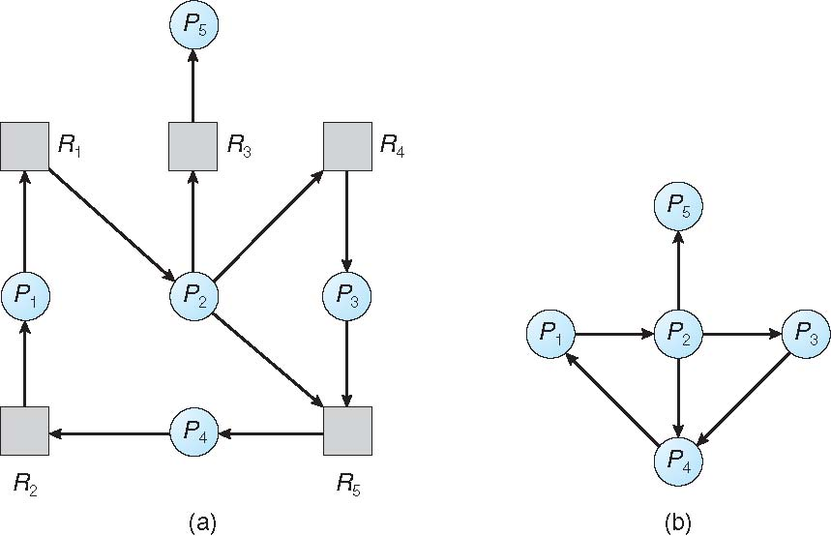
3.1) Resource-allocation graph and wait-for graph
For single instance resource type:
Create wait-for graph from RAG
Periodically run cycle detector
Resource-Allocation Graph
Corresponding wait-for graph

Slide 30
3.2) Several instances of a resource type
Let n = number of processes, and m = number of resources types.
Available: Vector of length m.
If available [j] = k, there are k instances of resource type R_{j} available
Allocation: n x m matrix.
If Allocation[i,j] = k then P_{i} is currently allocated k instances of R_{j}
Request: n x m matrix.
If Request[i,j] = k, then P_{i} is requesting k more instances of R_{j}

Slide 31
3.2) Several instances of a resource type
1. Let Work and Finish be vectors of length m and n, respectively. Initialize:
Work = Available
for i = 0, 1, …, n- 1 if Allocation_{i} ≠ 0 then Finish [i] = false
else Finish [i] = true
2. Find an i such that both:
(a) Finish [i] = false
(b) Request_{i} ≤ Work
If no such i exists, go to step 4
3. Work = Work + Allocation_{i} Finish[i] = true go to step 2
4. If Finish [i] == false for some i, then the system is in a deadlock state

Slide 32
Example of detection algorithm
Five processes P₀ through P₄; three resource types A (7 instances), B (2 instances), and C (6 instances)
Snapshot at time T₀:
Allocation Request Available
A B C A B C A B C
P₀ 0 1 0 0 0 0 0 0 0
P₁ 2 0 0 2 0 2
P₂ 3 0 3 0 0 0
P₃ 2 1 1 1 0 0
P₄ 0 0 2 0 0 2
Deadlock?
Sequence <P₀, P₂, P₃, P₁, P₄> will result in Finish[i] = true for all i

Slide 33
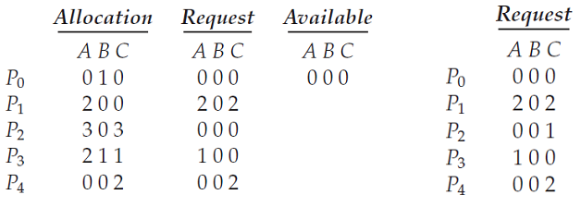
Example (Cont.)
P₂ requests an additional instance of type C
State of system?
Can reclaim resources held by process P₀, but insufficient resources to fulfill other processes; requests
Deadlock exists, consisting of processes P₁, P₂, P₃, and P₄

Slide 34
Recovery from deadlock: Process Termination
Abort all deadlocked processes
Abort one process at a time until the deadlock cycle is eliminated
In which order should we choose to abort?
Priority of the process
How long process has computed, and how much longer to completion
Resources the process has used
Resources process needs to complete
How many processes will need to be terminated
Is process interactive or batch?

Slide 35
Recovery from deadlock: Resource Preemption
Selecting a victim – minimize cost
Rollback – return to some safe state, restart process for that state
Starvation – same process may always be picked as victim, include number of rollback in cost factor

Slide 36

Questions?

